Slide 1
bef Defined

Slide 2
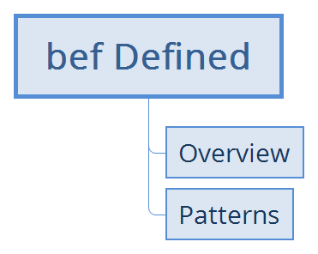

Slide 3
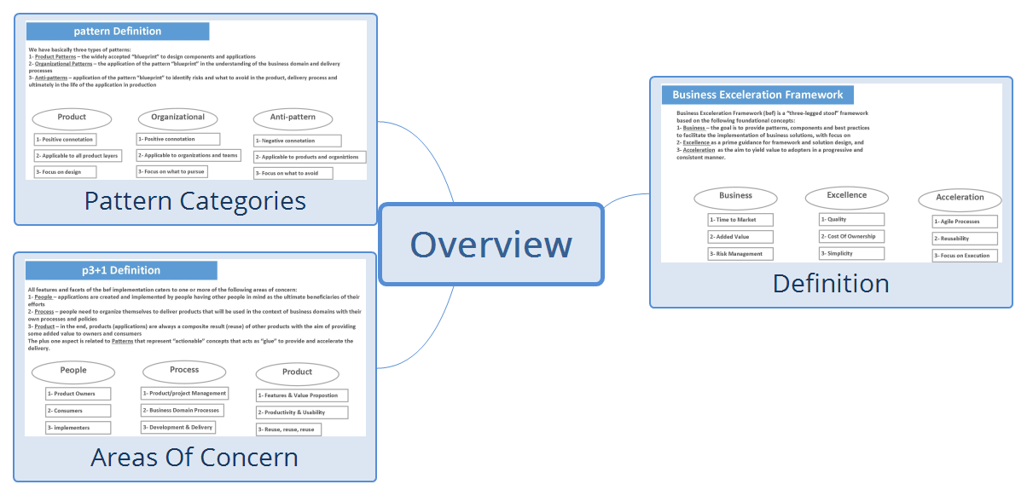
Overview

Slide 4
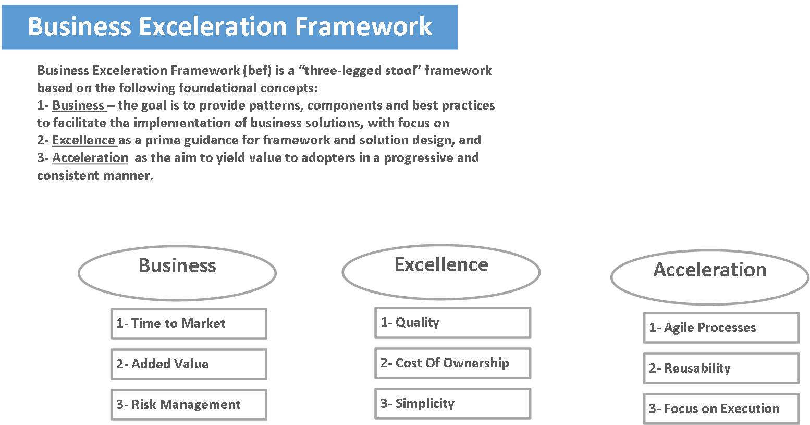
Definition

Slide 5
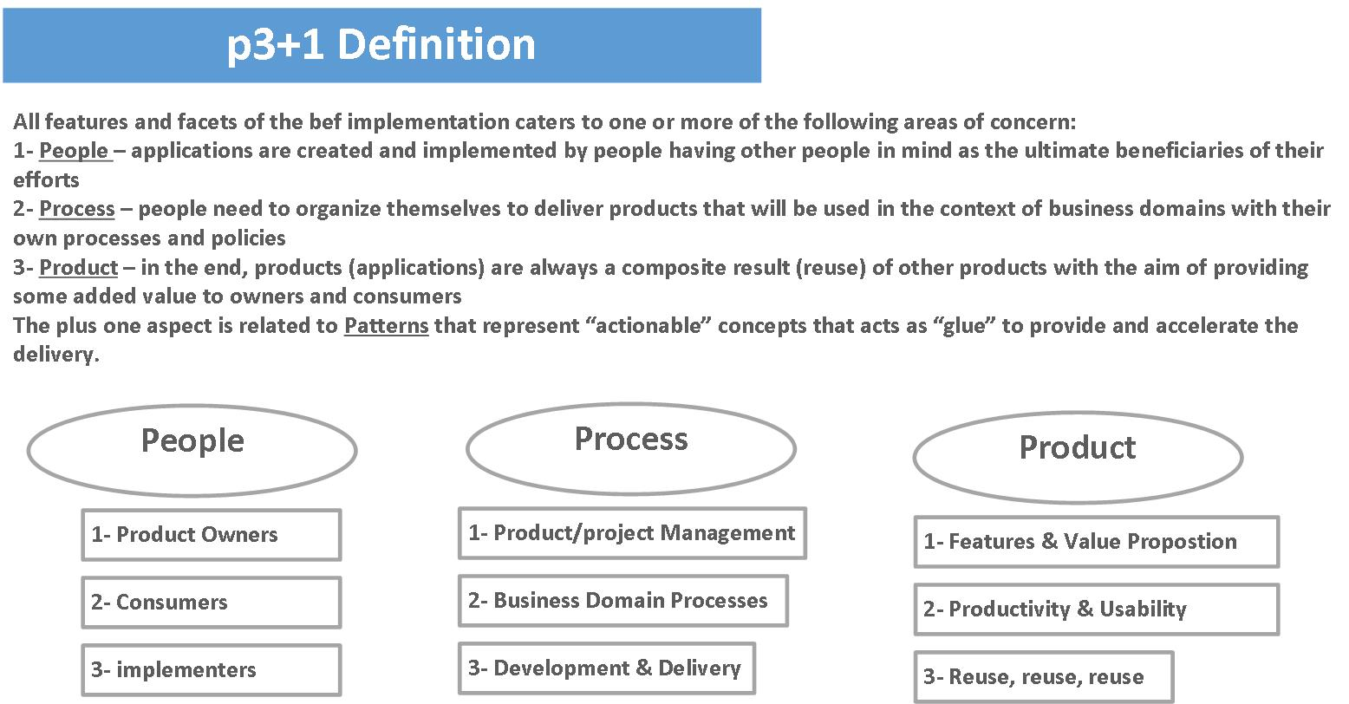
Areas Of Concern

Slide 6
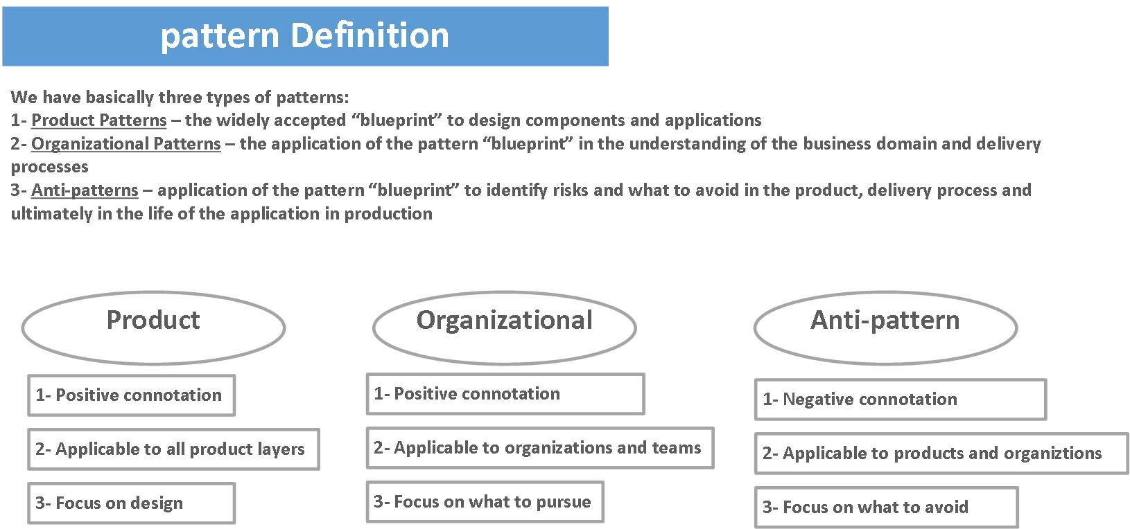
Pattern Categories

Slide 7

Patterns

Slide 8
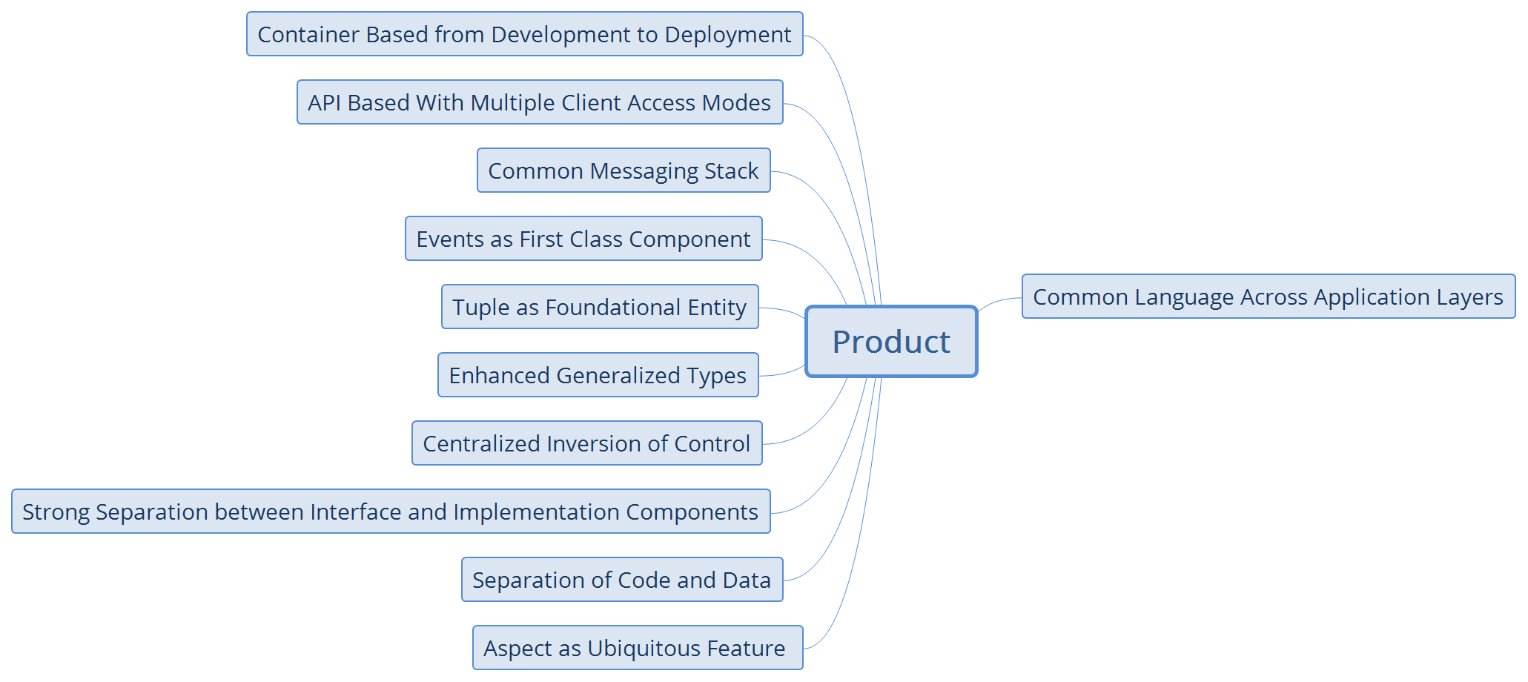
Product

Slide 9

Process

Slide 10

People

